Slide 1
Lane detection by using hybrid neural networks RNN+CNN and conventional
Ibrahim Ahmethan P2699379
Abhishek Ramsha P2702190
Batuhan Basal P2681345
Supervisor: Dr. Ioannis Kypraios

Slide 2
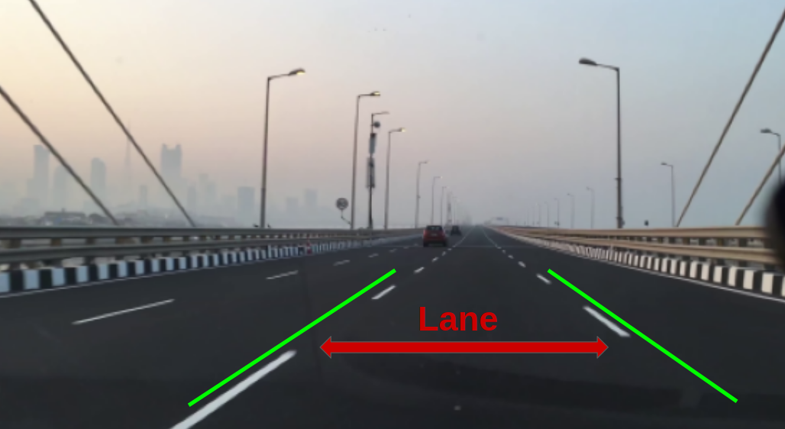
lane detection
lane detection is a critical component of self-driving cars and autonomous vehicles. It is one of the most important research topics for driving scene understanding. Once lane positions are obtained, the vehicle will know where to go and avoid the risk of running into other lanes or getting off the road

Slide 3
overview
Hybrid CNN and RNN artificial neural networks approach
Hough transform conventional approach
curve fitting conventional approach

Slide 4

What is CNN and how it works?

Slide 5
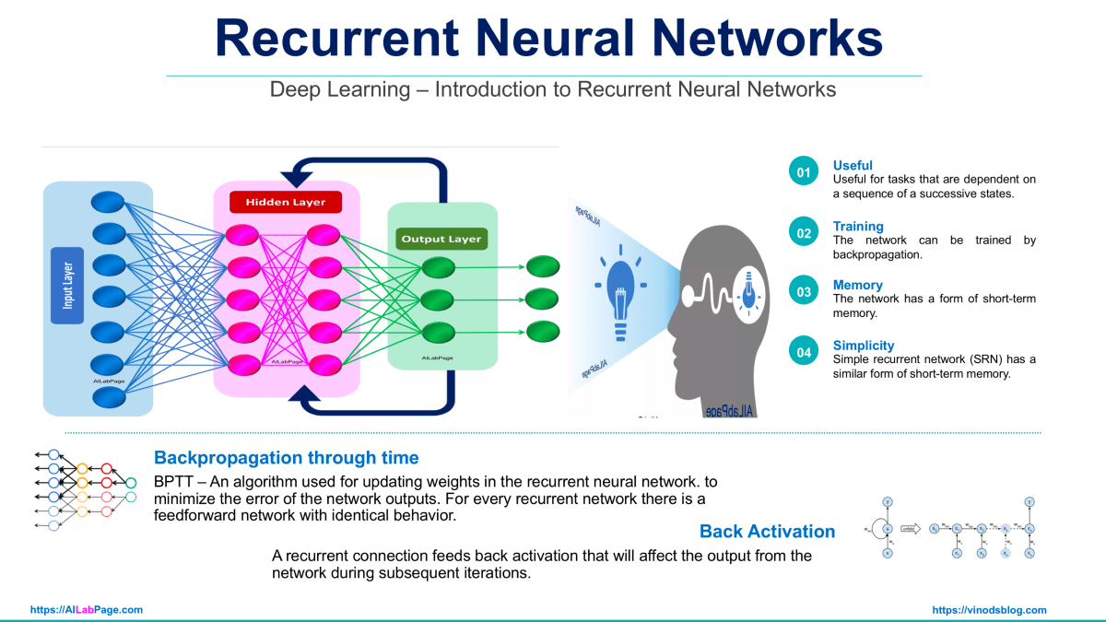
What is RNN and how it works

Slide 6
Hybrid neural network for lane detection
(system overview)
convolutional neural network (CNN) and recurrent neural network (RNN) are Combined together to achieve the lane detection
CNN + RNN are trained as end-to-end network
CNN abstracts features and reduces the size of the input
RNN predicts the current frame/image by using multiple previous frames of the driving scenes.

Slide 7
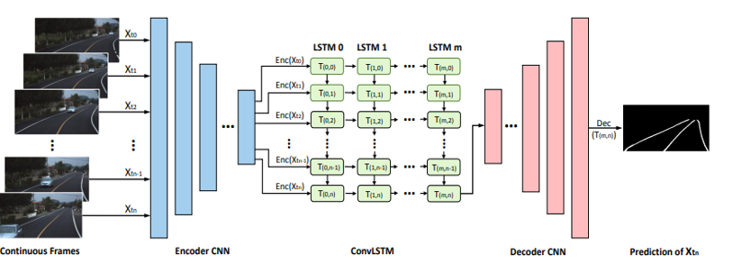
Network architecture of the model

Slide 8
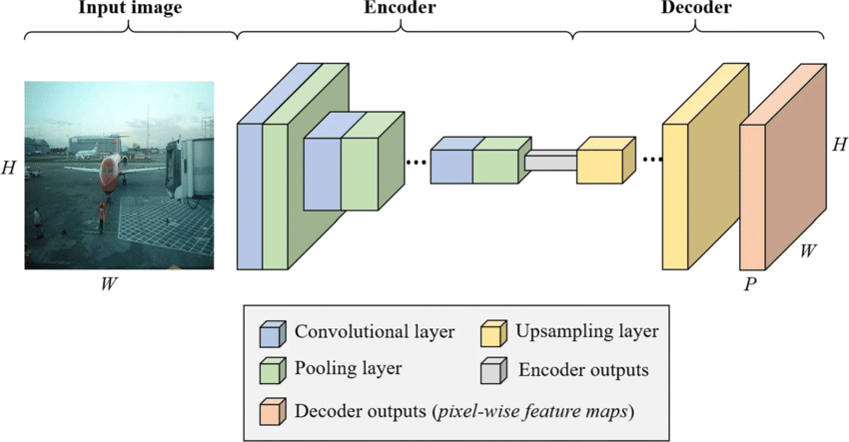
Basic structure of the CNN with encoder - decoder parts

Slide 9
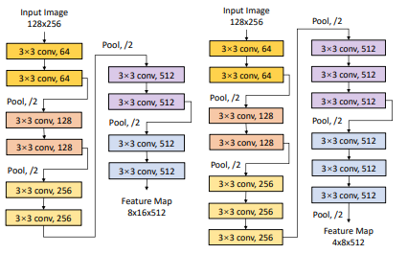
network design of UNet-ConvLSTM and network design of SegNet-ConvLSTM

Slide 10
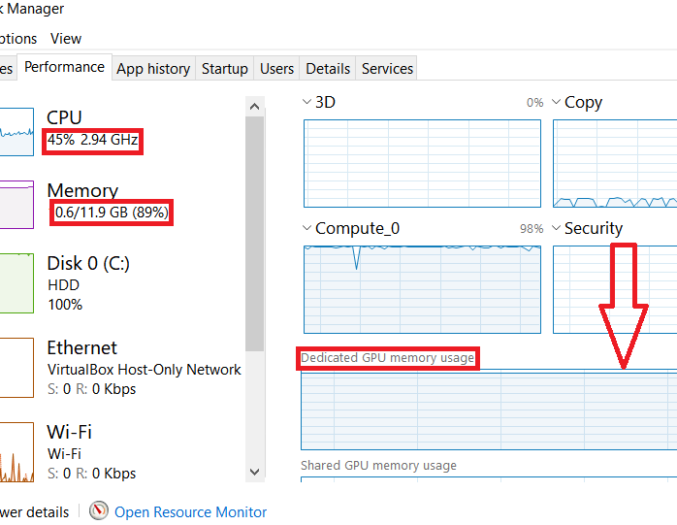
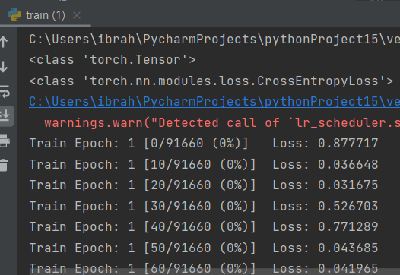
Limitations of the system

Slide 11
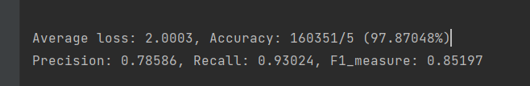
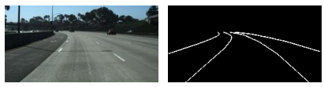
Results
the accuracy in the trained Unet-ConvLSTM model was 97.872%
The F1 score in the trained Unet-ConvLSTM model was 85.1%
the precision in the trained model Unet-ConvLSTM was 78.85%
The recall in the trained model Unet-ConvLSTM was 93.0%

Slide 12
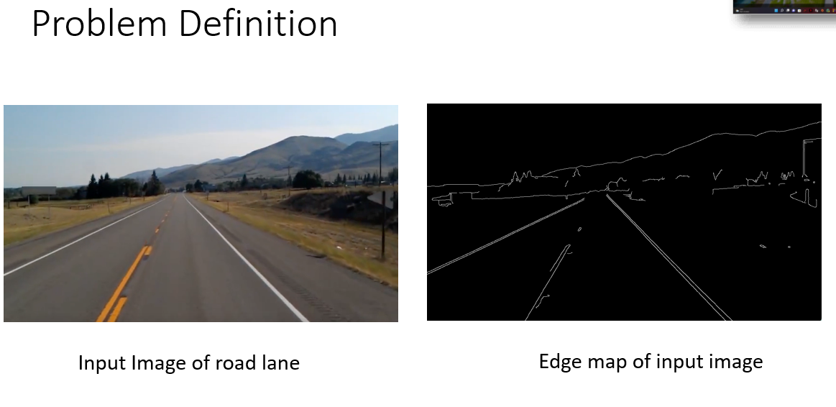
Hough transform and lane detection

Slide 13
Hough Transform
Extraneous Data :
Identify which points are actually fit the lines?
Incomplete Data :
Some part of the line are actually incomplete in the edge map, worse if the lines were being obstructed by other points.
Presence of noise :
Lots of edges close to line and even a little bit far away which don’t actually correspond to real edge.

Slide 14
Hough Transform
HT is invented in the early 1960s.
Gives very powerful ways to deal with this 3 problems.
It is work really well for line shape.
It takes an algorithm approach.

Slide 15
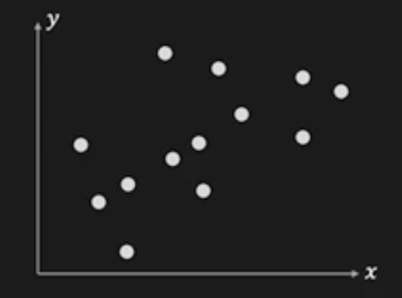
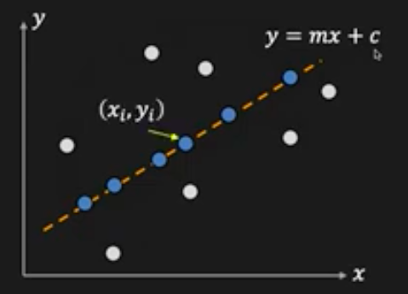
Hough Transform: Concept
Given : Edge Point
Task : Detect line , y = mx + c
Consider point (xi, yi)
yi = mxi + c -> c = - mxi + yi

Slide 16
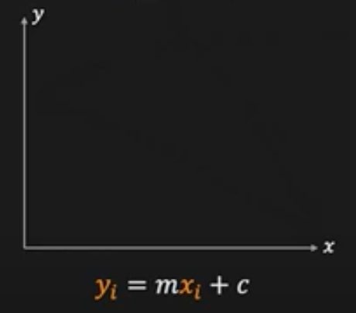
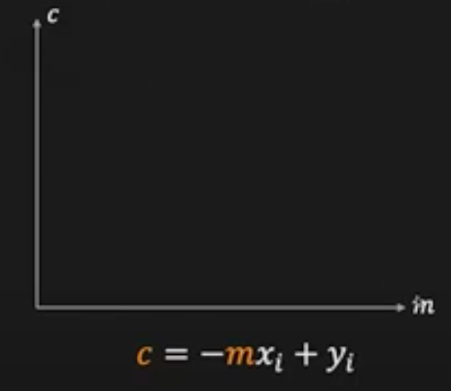
Hough Transform: Concept
Image Space : yi = mxi + c
Parameter Space : c = -mxi + yi

Slide 17
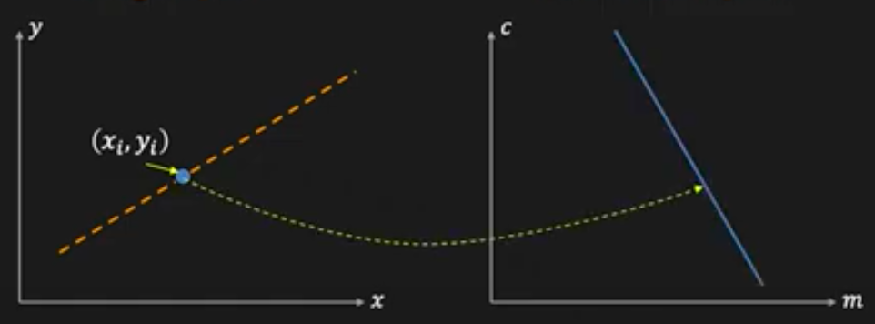
Hough Transform: Concept
Image Space : yi = mxi + c
Image Space : yi = mxi + c

Slide 18
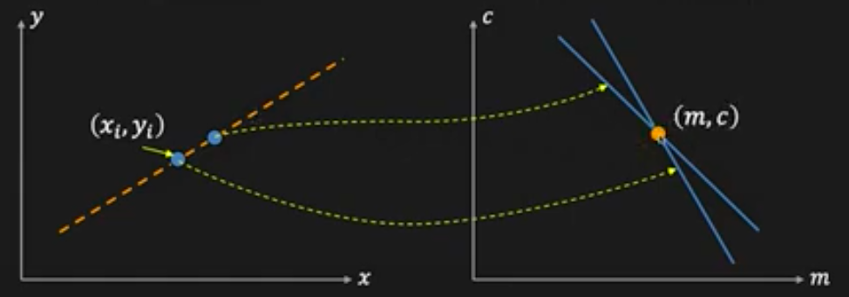
Hough Transform: Concept
Image Space : yi = mxi + c
Parameter Space : c = -mxi + yi

Slide 19
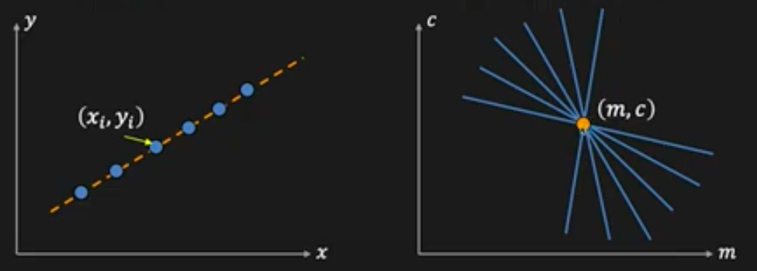
Hough Transform: Concept
Image Space : yi = mxi + c
Parameter Space : c = -mxi + yi

Slide 20
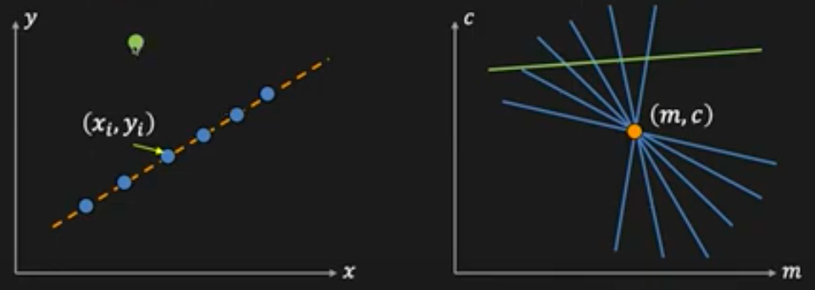
Hough Transform: Concept
Image Space : yi = mxi + c
Parameter Space : c = -mxi + yi

Slide 21
Line Detection Algorithm
Step 1 - Quantize parameter space (m, c)
Step 2 - Create accumulator array A(m, c)
Step 3 - Aet A(m, c) = 0 for all (m, c)
Step 4 - for each edge point (xi, yi)
A(m, c) = A(m, c) + 1
If (m, c) lies on the line : c = -mxi + yi
Step 5 – Find local maxima in A(m, c)

Slide 22
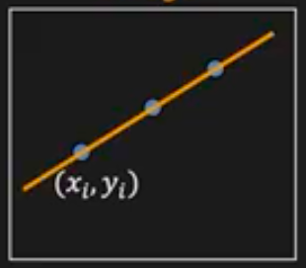
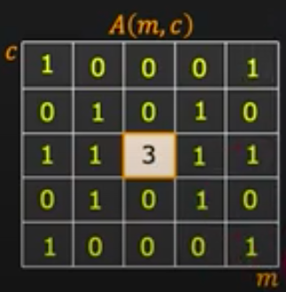
Line Detection Algorithm
Image

Slide 23
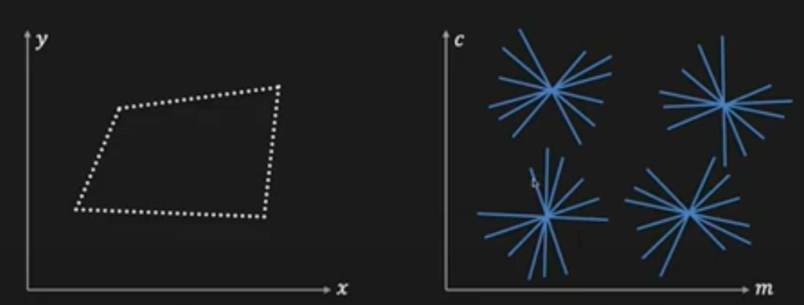
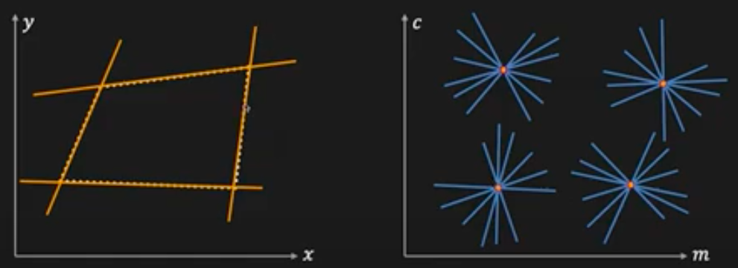
Multiple Line Detection

Slide 24

Better Result
Issues : Slope of the line - $∞$ $≤m ≤ ∞$
Large Accumulator
More memory and Computation
Solution : Use x sin $θ$ - y cos $θ$ + $ρ$ = 0
Orientation $θ$ is finite : 0 $≤$ $θ$ $< π$
Distance $ρ$ is finite

Slide 25
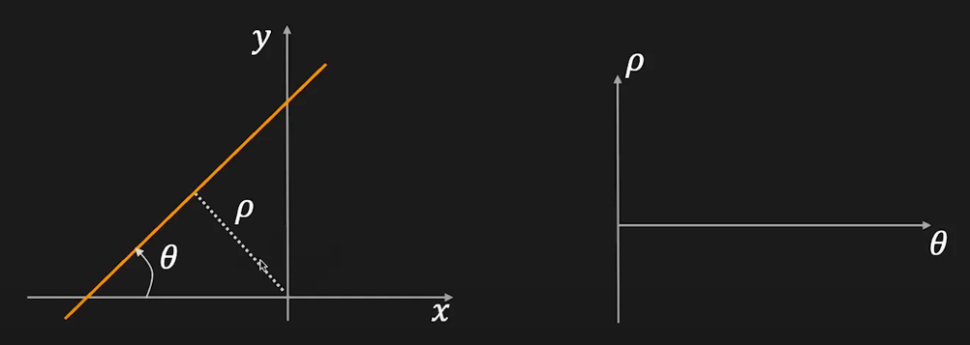

Batter Result
Image Space : x sin $θ$ - y cos $θ$ + $ρ$ = 0
Parameter Space : x sin $θ$ - y cos $θ$ + $ρ$ = 0

Slide 26
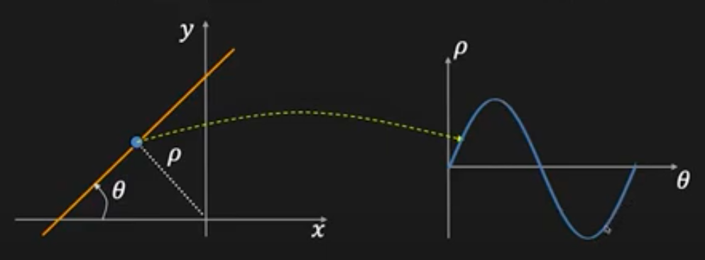

Batter Result
Image Space : x sin $θ$ - y cos $θ$ + $ρ$ = 0
Parameter Space : x sin $θ$ - y cos $θ$ + $ρ$ = 0

Slide 27
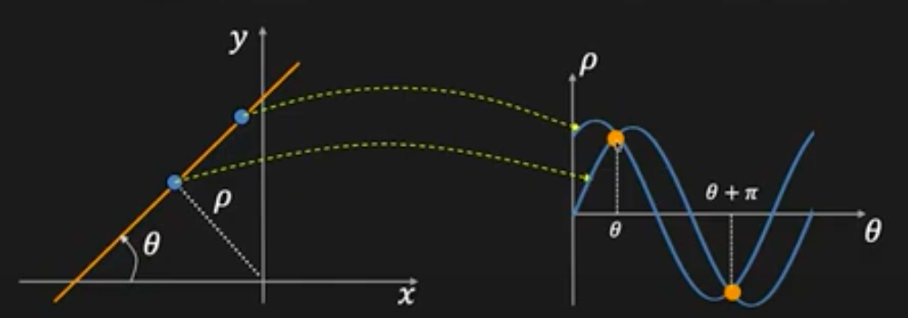


Batter Result
Image Space : x sin $θ$ - y cos $θ$ + $ρ$ = 0
Parameter Space : x sin $θ$ - y cos $θ$ + $ρ$ = 0

Slide 28
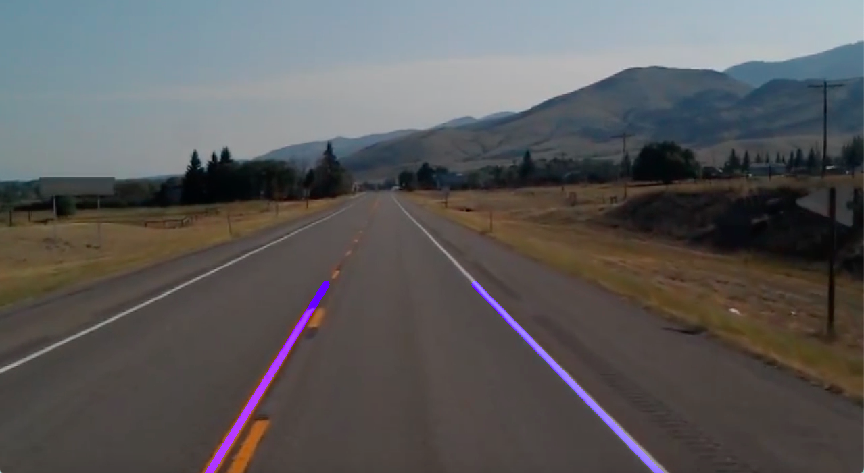
Results

Slide 29
Issues in Hough Transform
How large should the accumulator cell be?
Too large , unusual lines may be combined
Too minimal , and noise causes lines to be ignored
How many lines?
Calculate the points in the accumulator array
Handling incorrect edge location?
Increase area in accumulator rather then single point

Slide 30
Code Implementation
Step 1 : Take image/video as an Input.
Step 2 : Check input channel whether it is RGB or different.
Step 3 : Convert input into grayscale.
Step 4 : Apply edge detection on grayscale input.
Step 5 : Apply Hough Transform on edge map.
Step 6 : Draw line on detected lane.

Slide 31
Conclusion
Hough transform perform accurately for the simple shape like line but in terms of curve and other shape it is not accurate.
Also while in detecting lane there is other noise like dirt, missing lane , incomplete road marks are important factor that affect the accuracy and result.
Hough transform required pre processed data like edge map, filtered image.

Slide 32
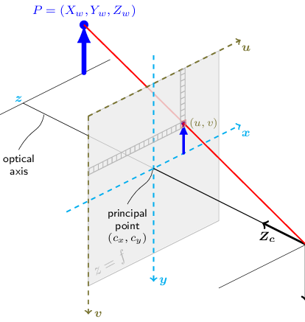
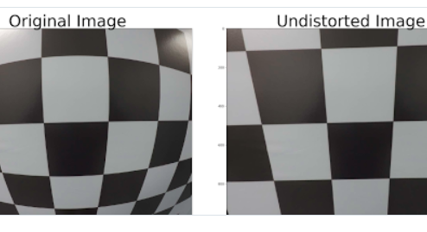
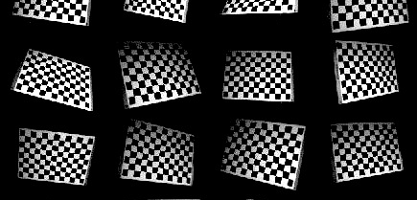
Curve fitting

Slide 33
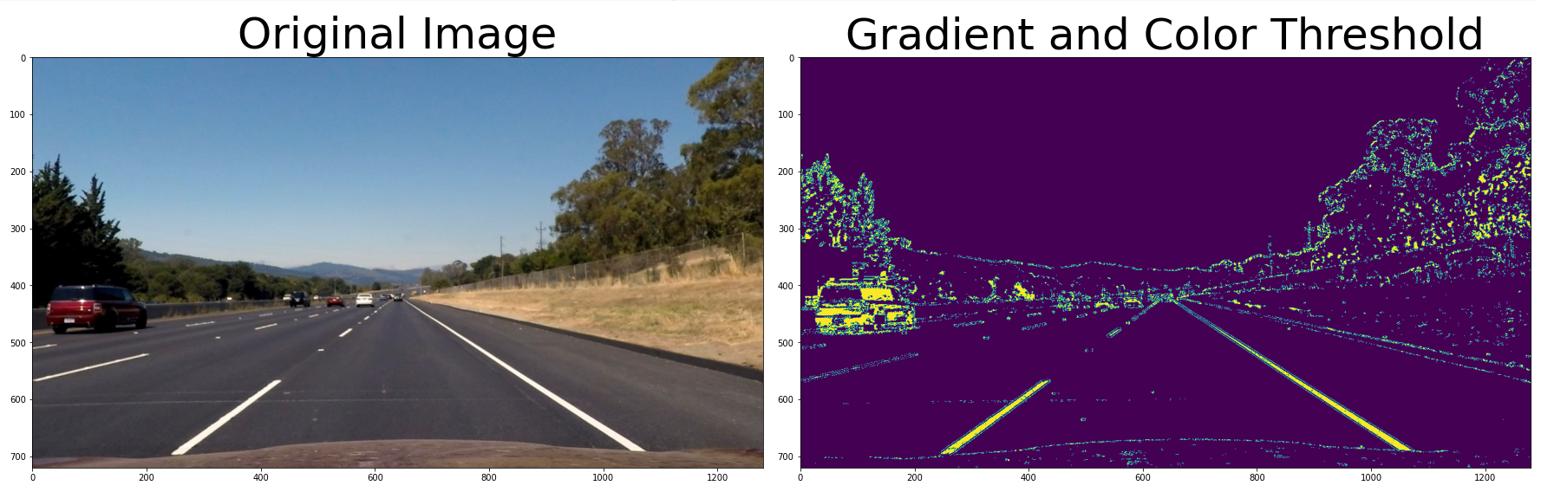
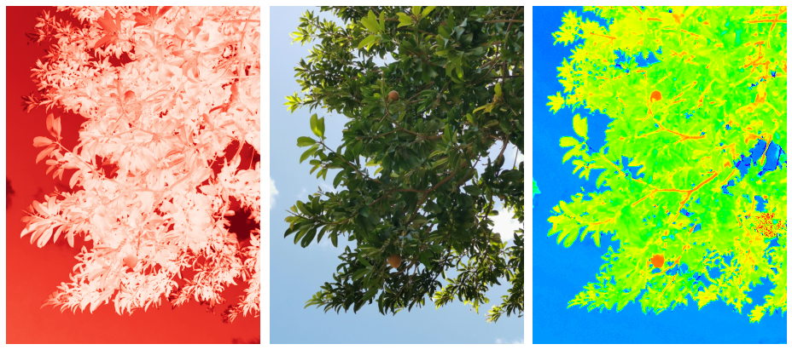
Curve fitting

Slide 34
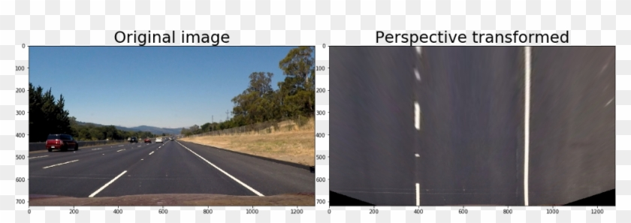
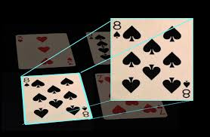
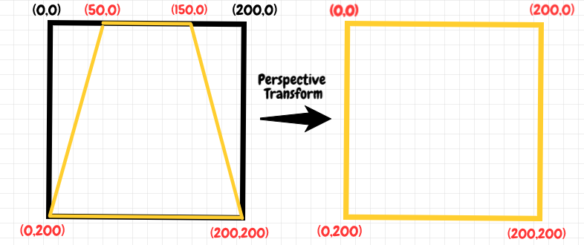
Curve fitting

Slide 35
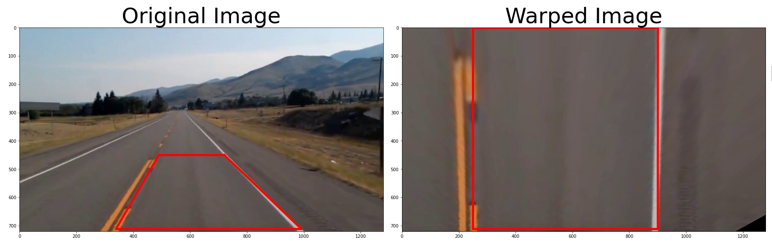
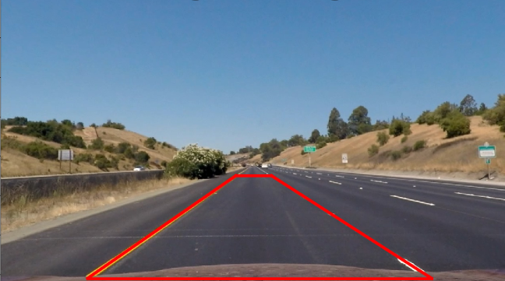
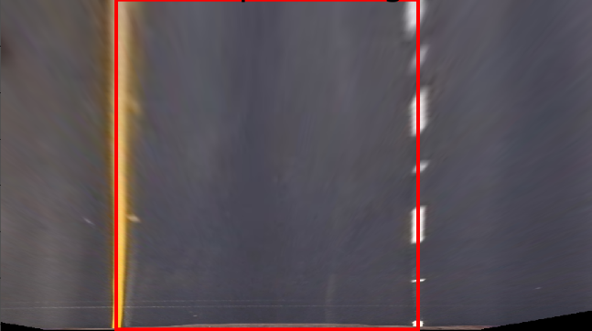
Curve fitting

Slide 36
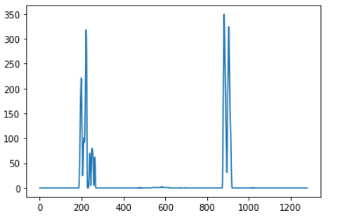
Curve fitting

Slide 37
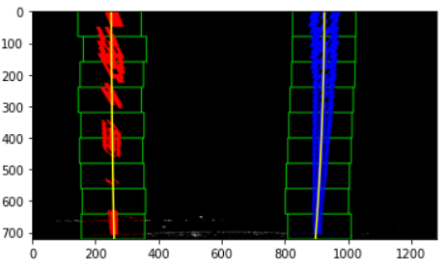
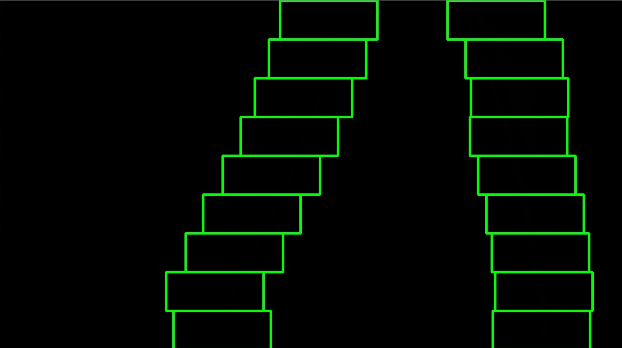
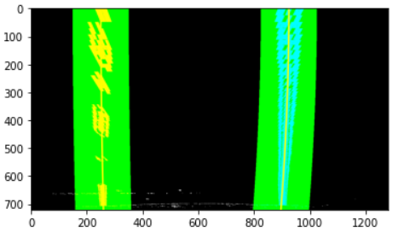
Curve fitting

Slide 38
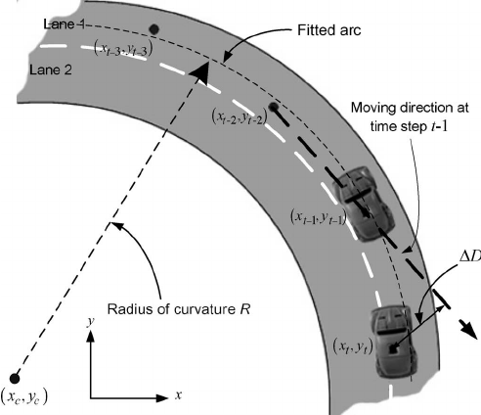
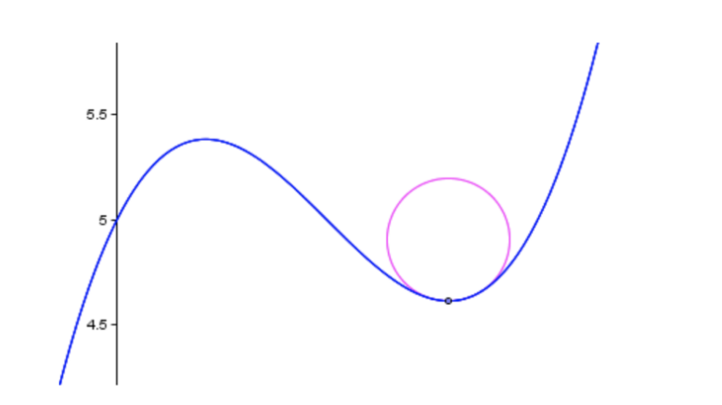
Curve fitting

Slide 39
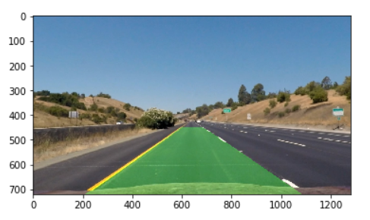
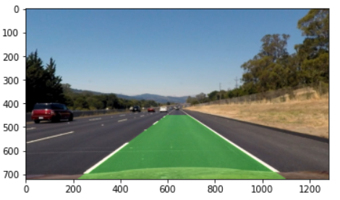
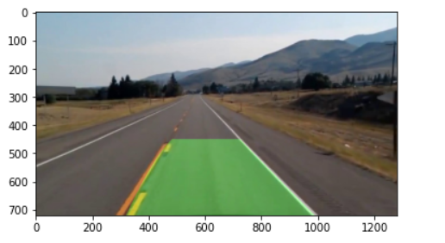
Curve fitting

Slide 40
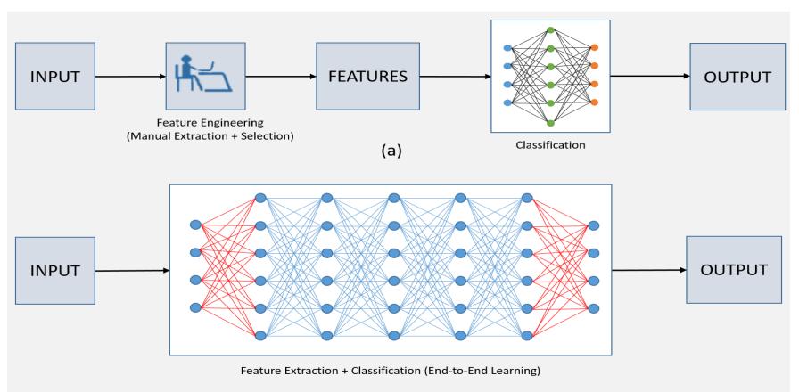
Comparison between deep learning and conventional methods

Slide 41
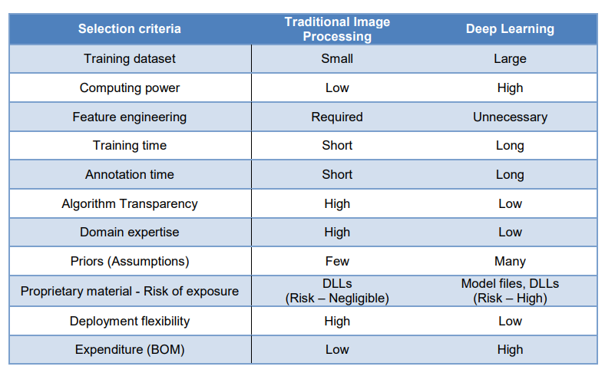
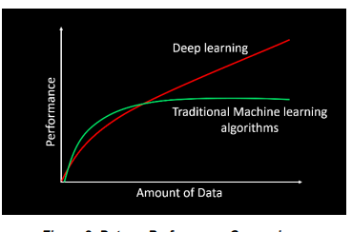
Comparison between deep learning and conventional methods

Slide 42
references
Mariut, F., C. Fosalau, and D. Petrisor. "Lane mark detection using Hough Transform" In Electrical and Power Engineering (EPE), 2012 International Conference and Exposition on, pp. 871-875. IEEE, 2012.
Ghazali, Kamarul, Rui Xiao, and Jie Ma. "Road lane detection using H-maxima and improved hough transform." In Computational Intelligence, Modelling and Simulation (CIMSiM), 2012 Fourth International Conference on, pp. 205-208. IEEE, 2012.
Ronghui Zhang, Yueying Wu, Wanting Gou, Junzhou Chen, "RS-Lane: A Robust Lane Detection Method Based on ResNeSt and Self-Attention Distillation for Challenging Traffic Situations", Journal of Advanced Transportation, vol. 2021, Article ID 7544355, 12 pages, 2021.
Zou Q, Jiang H, Dai Q, Yue Y, Chen L and Wang Q, Robust Lane Detection from Continuous Driving Scenes Using Deep Neural Networks, IEEE Transactions on Vehicular Technology, 2019.
Zhu, H.; Yuen, K.V.; Mihaylova, L.; Leung, H. Overview of environment perception for intelligent vehicles. IEEE Trans. Intell. Transp. Syst. 2017, 18, 2584–2601

